Slide 1
SPRING INTEGRATION
Date: Apr 20th, 2018
Name: Vishal Rangras
Title: Researcher | Engineer
Email: vishal.rangras@cignex.com

Slide 2
What we will talk about today?
Artificial Intelligence Origins
Applications of AI
Types of Machine Learning
Classification and Regression
Unsupervised and Semi-supervised Learning
Naive Bayes, SVM
Artificial Neuron and Neural Network
Learning Road Map
References / Credits

Slide 3
Enterprise Application Integration
Enterprise Application Integration (EAI) is the middleware that allows applications across an Enterprise to communicate and work together.
According to Gartner, EAI can be defined as unrestricted sharing of data and business processes among any connected application or data sources in the enterprise.
Why do we need EAI?
Sometimes, Applications share data and processes that they probably weren't originally designed to share and in ways that may not have been even conceivable at the time of their creation.

Slide 4
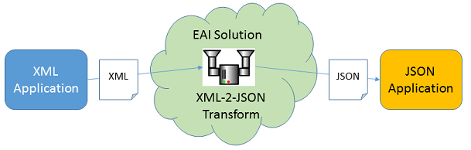
Looking from a problem perspective
Producer application provide data in XML Format.
Consumer application can only consume JSON Format data.
EAI Solution transforms XML data to JSON data so it can be consumed.

Slide 5
What is Spring Integration?
There are well known solutions to common needs in EIA world, which are called Enterprise Integration Patterns (EIP). EIPs can be considered as Desing Patterns of EIA world.
Spring Integration(SI) is a physical embodiment of the EIP in Java which is built on top of Spring Framework.
With Spring Integration, you can leverage features of Spring like:
Dependency Injection and Spring Container.
POJO driven capabilities and Bean Wiring.
AOP
Spring Security
Other benefits of Spring Ecosystem

Slide 6
Understanding main components of EIA

Slide 7
Channels
Producer (Sender)
Consumer (Receiver)
Pipe
Message
Producer and Consumer communicate with each other via Pipe / Channel.
Classified into: Pollable Channels and Subscribable Channels
In Spring Integration:
Pipes are called Channels.
Producers and Consumers are known as Endpoints.
The communication occurs via Messages.
Message may consist of either some data or some event information.

Slide 8
Messages
Message consits of the Header and the Payload.
Header contains system information. E.g. timestamp, id, some metadata.
Payload contains the data or event that's needs to be exchanged inside of SI environment.
Message
Header
Payload

Slide 9
Message Channels
Pollable Channels
Subscribable Channels
Consumers actively poll to receive messages.
Requires a queue with designated capacity to hold the messages.
Point-to-point channel with only one receiver of a message in the channel.
Used for sending “document ” messages between endpoints.
If there are more then one subscribers, it picks 1st one.
Multiple subscribers subscribe to the channel.
Doesn't buffer messages and don't have any queue.
Messages are delivered to all the registered subscribers.
Used for sending “event” messages.
Notify subcribers that something happened and to take appropriate action.

Slide 10
Adapters
Adapters are endpoints that connects a channel to external system.
Inbound Adapters: Brings messages to the SI Channel
Outbound Adapters: Get messages from SI Channel to outside applications.
It provides a bridge between SI and external systems / services.
Separation of Concern of your Message API from transports and Protocols.
File
Stream
JMS
Mail
Feed (RSS, Atom)
JDBC JPA
Twitter
UDP
MongoDB

Slide 11
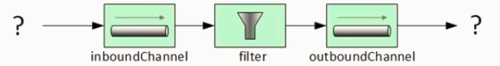
Filters
Filters:
Endpoints that sits between channels.
Accept or reject messages from one channel to the next.
Selection occurs based on message's payload or metadata.
Discard Channel: To route the rejected messages.
Expression Filter: Uses evaluated SpEL against messages to select messages.
Xpath Filter: Uses Xpath expression againts XML Payload to select messages.
XML Validating Filter: Uses XML Schema to validate XML Payload messages.
MessageSelector interfact to implement custom Filter.

Slide 12
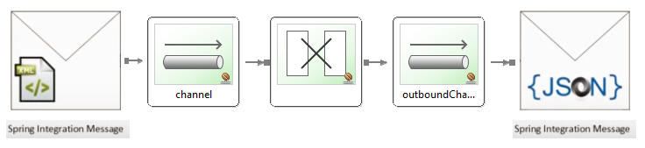
Transformers / Translators
Endpoints that converts the payload or structure of the message into a modified message with a different structure.
e.g.: Coverts XML payload into a JSON Payload message.
Allows provider and consumer of the information to communicate via SI without having to settle on common format.

Slide 13
Routers
Routers acts as message distribution components.
Takes messages from one channel.
Distribute messages to one or more channels.
Provide forks in the road of message channels.
Content Routers:
Examine incoming message content to determine destination of message.
Uses payload type or header value to determine route.
Recipent List Routers:
Incoming messages are delivered to all listed recipient channels.
Don't examine the message.

Slide 14
Applications of Artificial Intelligence
Natural Language Processing
01
Computer Vision
02
Machine Learning and Data Analytics
03
Robotics
04
General Intelligence
05

Slide 15


Sentiment Analysis
Aspect
Opinion Unit
Language
Processing
Multi-label
Classifiers
Scores
Sentiment
Objective: Improvements in Operations and Customer Service.
E.g.: “The location was good, but the service was lacking.”
Result:
Aspect : Location, Score : 1
Aspect : Service, Score : -1

Slide 16
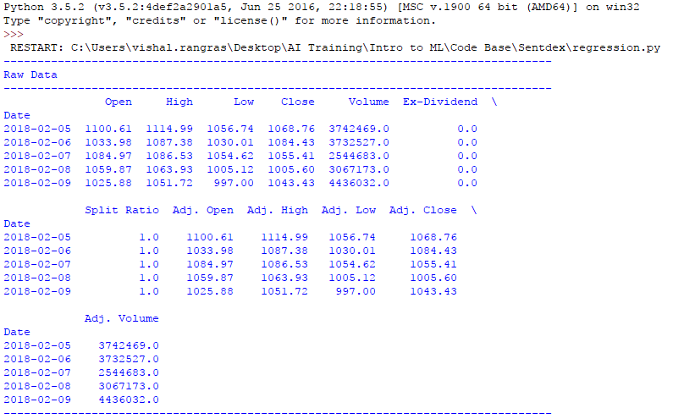
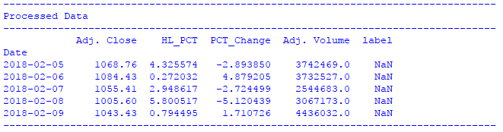
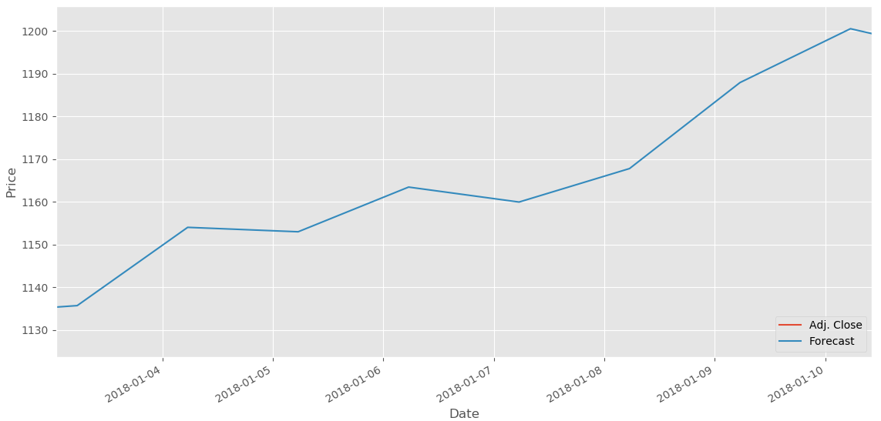
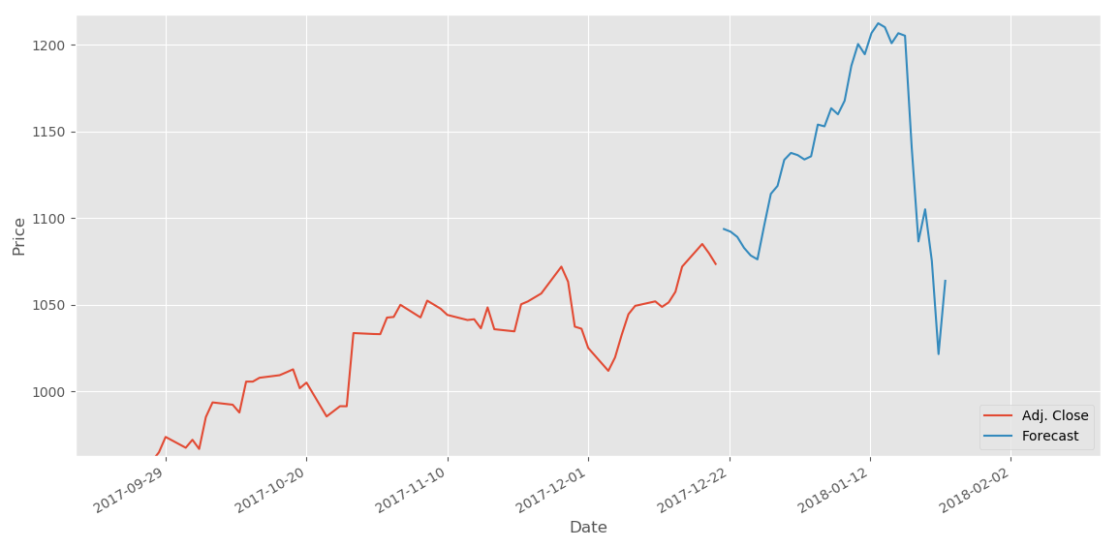
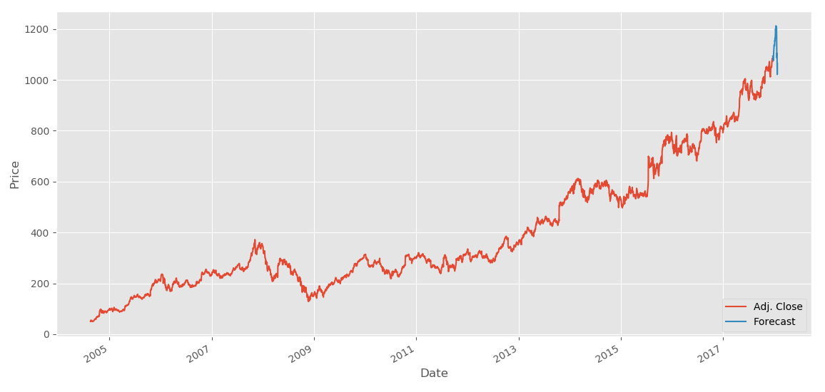
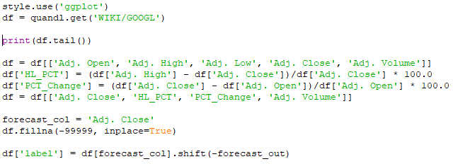
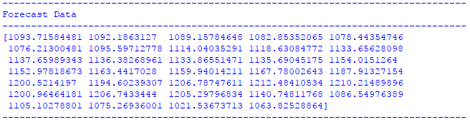
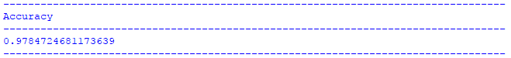
Stock Price Prediction

Slide 17
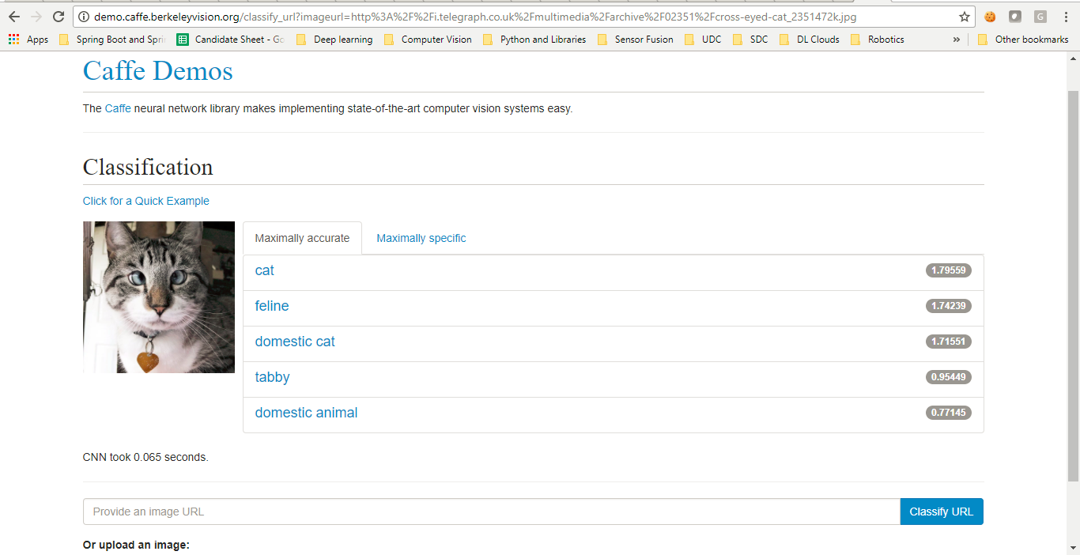
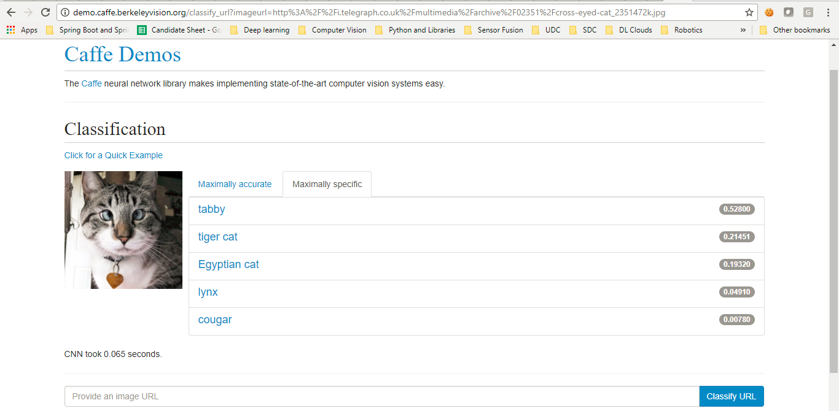
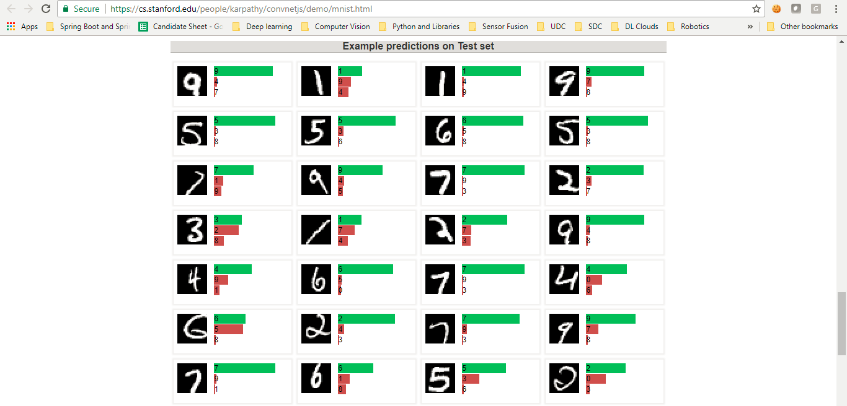
Image Classification

Slide 18
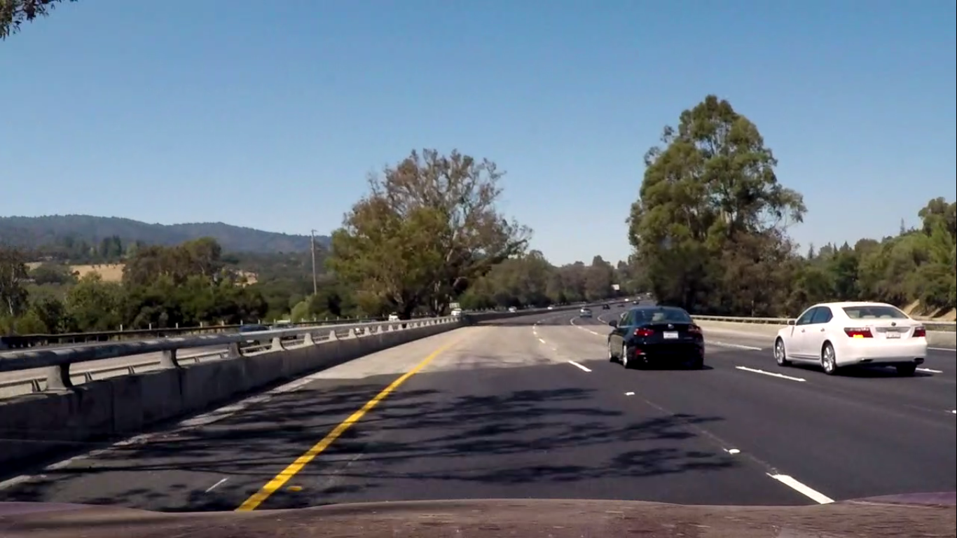
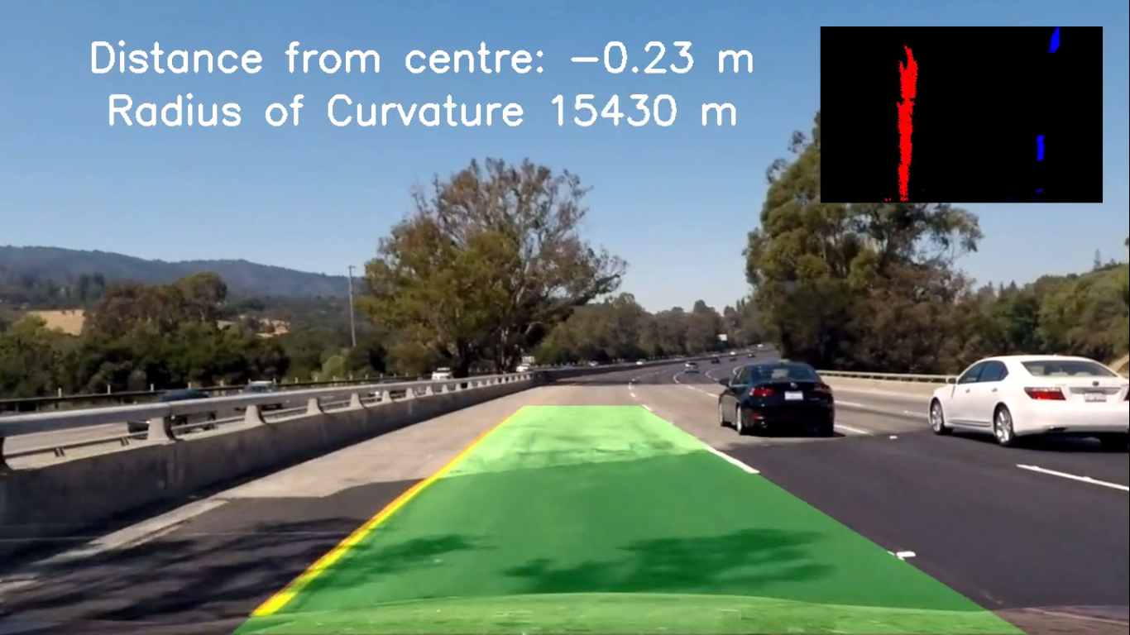
Lane Detection

Slide 19
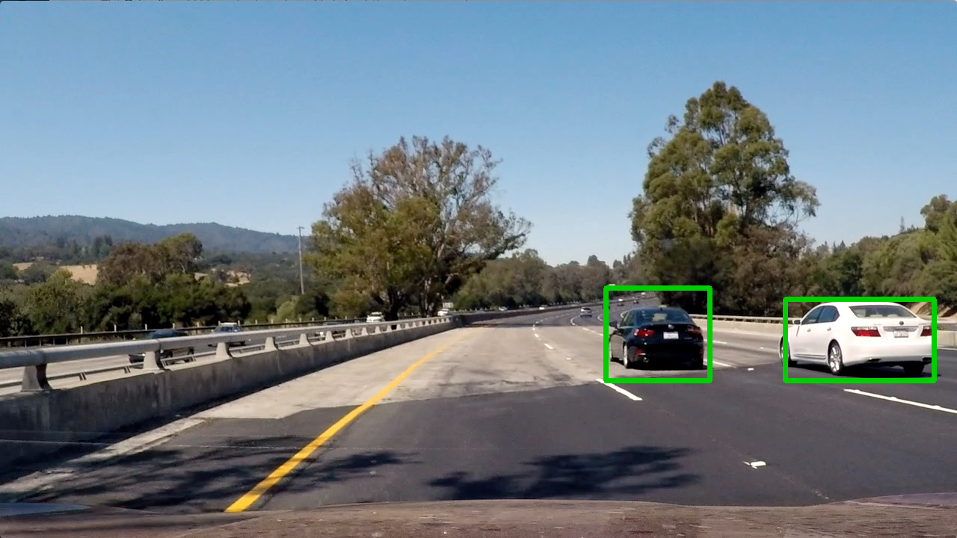
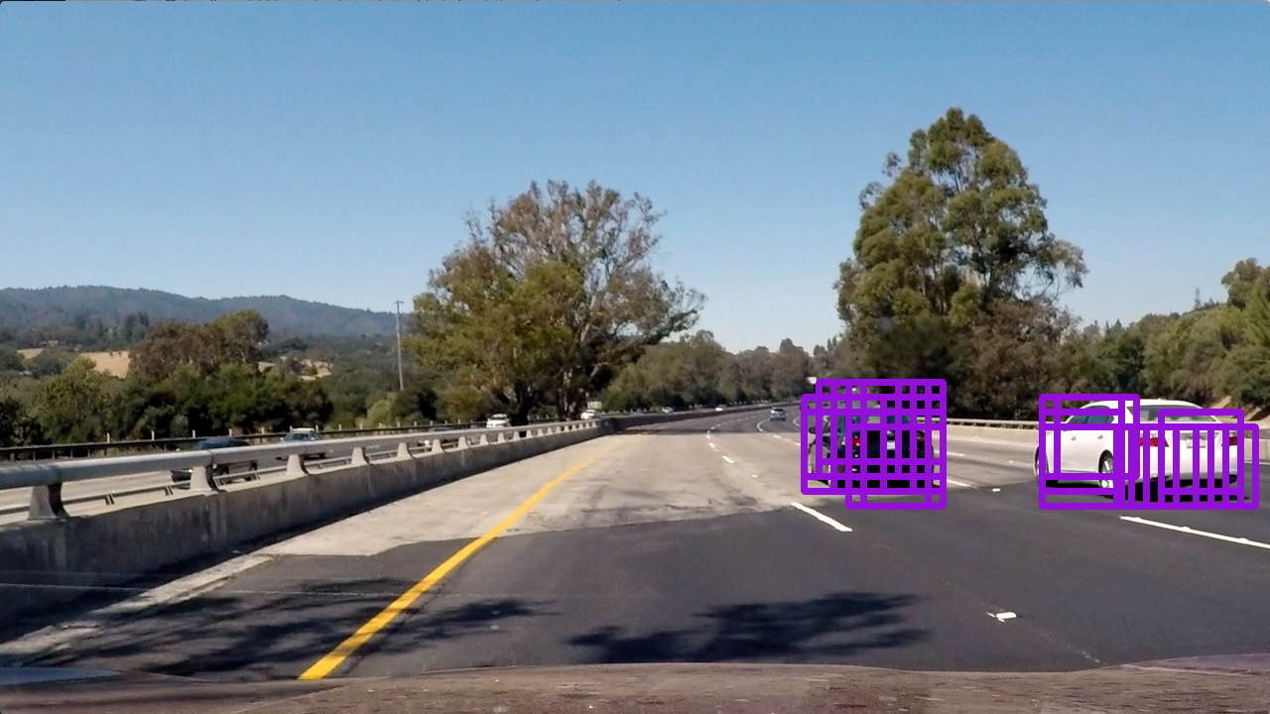
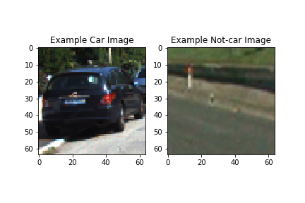
Object Detection

Slide 20
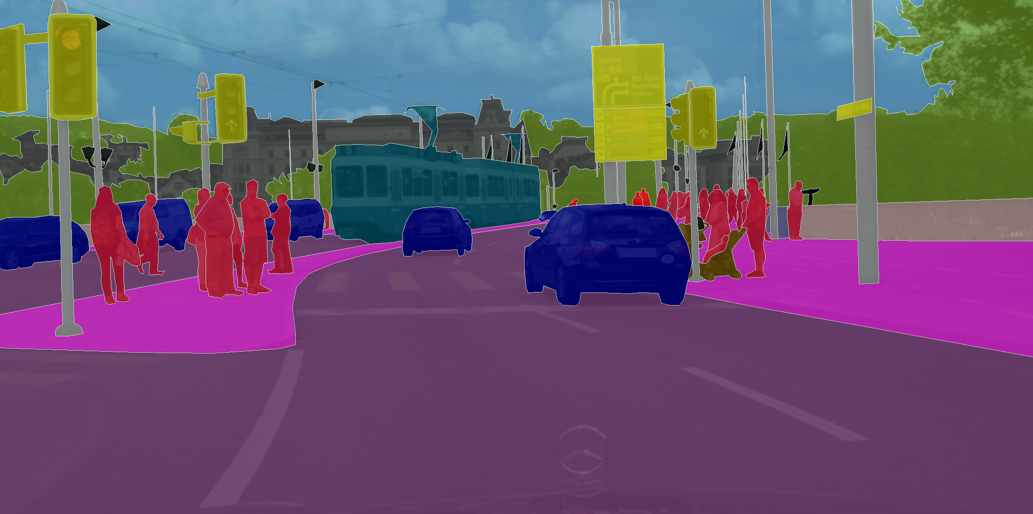
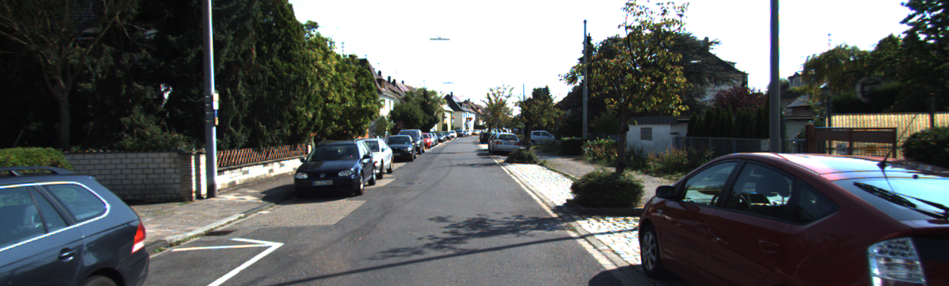
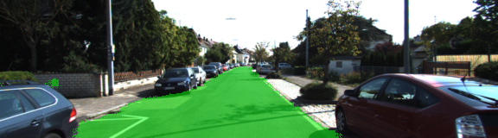
Semantic Segmentation

Slide 21
Types of Machine Learning
Supervised Learning
Unsupervised Learning
Semi-Supervised Learning

Slide 22
Supervised Learning
You have input variables (x) and an output variable (Y) and you use algorithm to learn the mapping function from the input to the output.
Y = f(x)
Examples include:
Linear Regression, Gradient Descent
Naive Bayes, SVM, Decision Trees, Random Forest.
Neural Networks, CNN, LSTM.
Given Output Label
Given Input Data
Find the mapping function

Slide 23
Classification and Regression
Classification: A classification problem is when the output variable is a category.
It is simply the process of taking some kind of input, say x, and mapping it to some discrete number of labels (something like True or False).
E.g.: MNIST, German Traffic Signal classifier, ImageNet classifier
Regression: A regression problem is when the output variable is a real value.
It can be considered as mapping from some input space to some real number (potentially an infinite number of real numbers).
E.g.: Predicting steering angle of car, Property valuation, Stock price prediction.

Slide 24
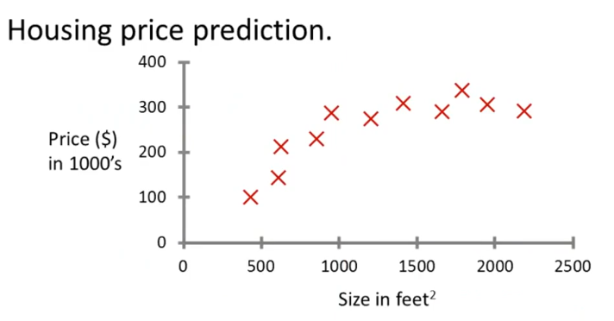
Supervised Learning - Example
Malignant Cancer Prediction
Age
Tumor Size
Regression Problem
Classification Problem

Slide 25
Unsupervised Learning
You only have input data (x) and no corresponding output variables.
All the data points have no label or the same label.
There is no correct answer and there is no supervision.
Algorithms themselves discover interesting structure in data.
►Goal: To model the underlying structure or distribution in data in order to learn more about the data.
Examples inlcude:
K-means Clustering
Anomaly and Outlier Detection
Collaborative Filtering and Recommendor Systems

Slide 26
Semi-Supervised Learning
You have a large amount of input data (X) and only some of the data is labeled (Y).
Many real world machine learning problems fall into this area.
Unsupervised learning techniques to discover and learn the structure in the input variables.
Supervised learning techniques to make best guess predictions for the unlabeled data.
Example: A photo archive where only some of the images are labeled, (e.g. dog, cat, person) and the majority are unlabeled.
Supervised Learning
Semi-supervised Learning
Unsupervised Learning

Slide 27


Slide 28
Supervised or Unsupervised?
Q. Given email as spam / not spam, learn a spam filter.
A. Supervised Learning
Q. Given set of news articles found on web, group them into set of articles about the same story.
A. Unsupervised Learning
Q. Given a database of customer data, automatically discover market segments and group customers into different market segments.
A.Unsupervised Learning
Q. Given a dataset of patients diagnosed as either having diabetes or not, learn to identify new patients as having diabetes or not.
A. Supervised Learning

Slide 29
Classification or Regression?
Q. Given picture of a person, predict their age.
A. Regression
Q. For each customer, examine if the account is been hacked or not.
A. Classification
Q. Large inventory of identical items. Predict how many of those will be sold by next 3 months.
A. Regression
Q. For a particular house, predict if it could be sold at buyer's expected price or not.
A. Classification

Slide 30
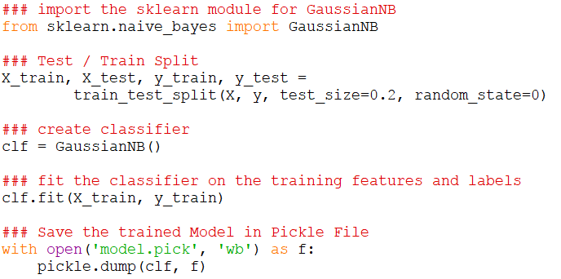
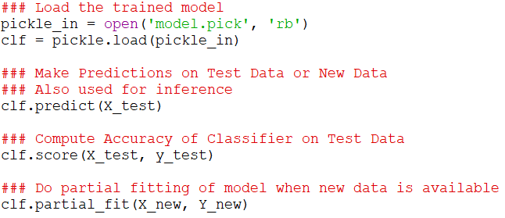
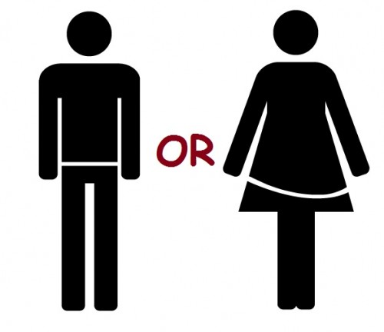
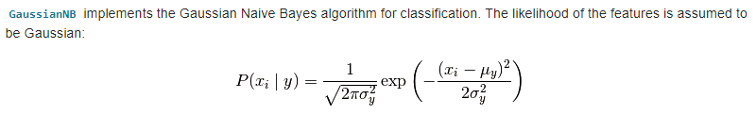
Naive Bayes Algorithm
Bayes Formula:
P(male | h, w) = P(h | w, male) * P (w | male) * P(male) / P(h, w)
Height | Weight | Label
181 | 80 | Male
177 | 70 | Female
160 | 60 | Female
154 | 54 | Female
166 | 65 | Male
190 | 90 | Male
171 | 75 | Female

Slide 31
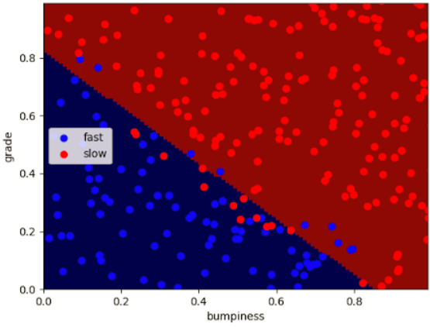
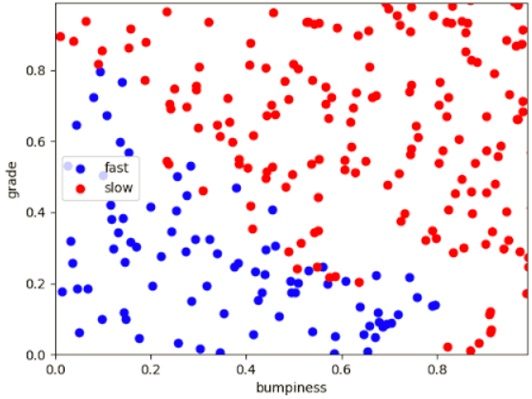
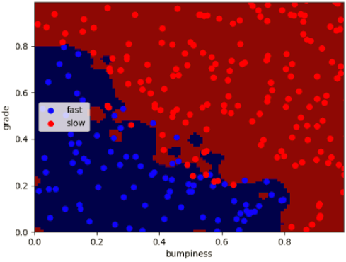
Support Vector Machine
Goal: To find the line which separates data linearly.
The best fit line would be the one which would maximize the distance to the nearest point and it does it relative to all (both) the classes. The distance is called Margin.
Support Vector Machine puts first and foremost the correct classification of the labels, and then maximize the margin.

Slide 32
SVM - Key Points
SVM supports non-linear decision boundaries using Kernel Tricks.
Kernel Functions takes low dimensional input space and map it to a very high dimensional space. The data which was not linearly separable gets converted into a linearly separable data due to Kernel Trick.
C Parameter: Large value penalty parameter C will imply more training points to be classified correctly and a wiggly decision boundary. Small penalty will imply ignoring outliers and getting a smooth decision boundary.
Gamma: It defines how far the influence of a single training example reaches. Low value of Gamma implies every point has a far reach and high value of Gamma implies each training example has a close reach.
Works really well in the complicated domains where there is a clear margin of separation. Don't work well with noisy data like where classes are overlapping.
y
z
x
SVM
x
y
Label
x
z = x² + y²

Slide 33
Decision Tree
Allows you to do non-linear decision making using multiple linear decision surfaces.
Allows you to ask multiple linear questions, one after another.
During the learning process, the algorithm takes the input data and generates a decision tree, which can help you classify the data.
Emphasizes on maximizing information gain while reducing entropy.
Test
Grade
Greater then
Threshold
Lesser then
Threshold
Test
Reject
Greater then
Threshold
Lesser then
Threshold
Accept
Reject
Grade

Slide 34
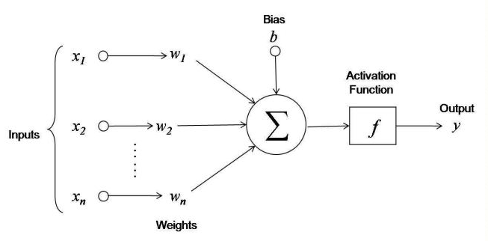
Perceptron - Artificial Neuron

Slide 35
Perceptron - Working
x₁
= 1
= 0.8
Sum & Bias
w₁
b
= 1.5
0.5
x₂
y = 1
= 2
y = 0
= -2
w₂
0.2
x₁w₁ + x₂w₂ + x₃w₃ + b
θ
= 2
= 1.7
w₃
= 2.9
1*0.5
+ 2*0.2
+ (-1)*0.7
+ 1.5
0.7
0.5 + 0.4 - 0.7 + 1.5 = 1.7
x₃
= -1
0.8*0.5
+ (- 2)*0.2
+ 1.2 * 0.7
+ 1.5
= 1.2
Weights
Activation
0.4 - 0.4 + 0.84 + 1.5 = 2.9

Slide 36
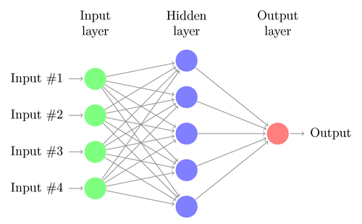
Neural Network

Slide 37
Learning Road Map
Pre-requisite:
Linear Algebra
Probabilistic Statistics
Programming
Machine Learning
Berkley's ML Blogs
Intro to ML - Udacity
Coursera ML Course
Georgia Tech ML Course - Udacity
Kaggle Datasets
Deep Learning
Intro to DL - Udacity
deeplearning.ai - Coursera
Fast.ai
neuralnetworksanddeeplearning.com
Computer Vision
Georgia Tech CV Course - Udacity
PyImageSearch blogs
LearnOpenCV blogs

Slide 38
References
Stanford CS231 Classroom
Udacity - Introduction to Machine Learning
Udacity - Advanced Machine Learning - Georgia Tech
Coursera - Introduction to Machine Learning
Coursera - deeplearning.ai
MIT - Deep Learning 6.S094
http://neuralnetworksanddeeplearning.com
machinelearningmastery.com
Khan Academy - Statistics and Linear Algebra
Fast AI - Deep Learning Course
Udacity - Computer Vision - Georgia Tech
Caffe and ConvnetJS Official Sites

